Slide 1
Fall 2024 Lecture 03 BS(CS) Protocols and Service Models
National University of Computer & Emerging Sciences

Slide 2
Protocol “layers”
Networks are complex,
with many “pieces”:
hosts
routers
links of various media
applications
protocols
hardware, software
Question:
is there any way of organizing structure of network?
…. or at least our discussion of networks?

Slide 3

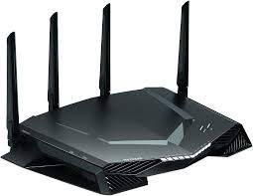
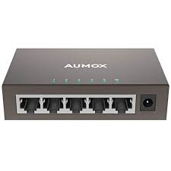

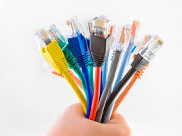
TCP
MAC
FTP
applications
IPv4
HTTP
DHCP
DNS
UDP
SSH
ICMP
ARP
Routing protocols
hosts
RIP
hardware, software

Slide 4
Organization of air travel
ticket (purchase)
baggage (check)
gates (load)
runway takeoff
airplane routing
ticket (complain)
baggage (claim)
gates (unload)
runway landing
airplane routing
airplane routing
a series of steps

Slide 5
Layering of airline functionality
ticket (purchase)
baggage (check)
gates (load)
runway (takeoff)
airplane routing
ticket (complain)
baggage (claim
gates (unload)
runway (land)
airplane routing
ticket
baggage
gate
takeoff/landing
airplane routing
airplane routing
airplane routing
departure
airport
intermediate air-traffic
control centers
arrival
airport
layers: each layer implements a service
via its own internal-layer actions
relying on services provided by layer below

Slide 6
Why layering?
dealing with complex systems:
modularization eases maintenance, updating of system
change of implementation of layer’s service transparent to rest of system
e.g., change in gate procedure doesn’t affect rest of system
Led to flexibility in modifying and developing network architectures.
Accommodates incremental changes.

Slide 7
We use the concept of layers in our daily life. As an example, let us consider two friends who communicate through postal mail. The process of sending a letter to a friend would be complex if there were no services available from the post office.

Slide 8
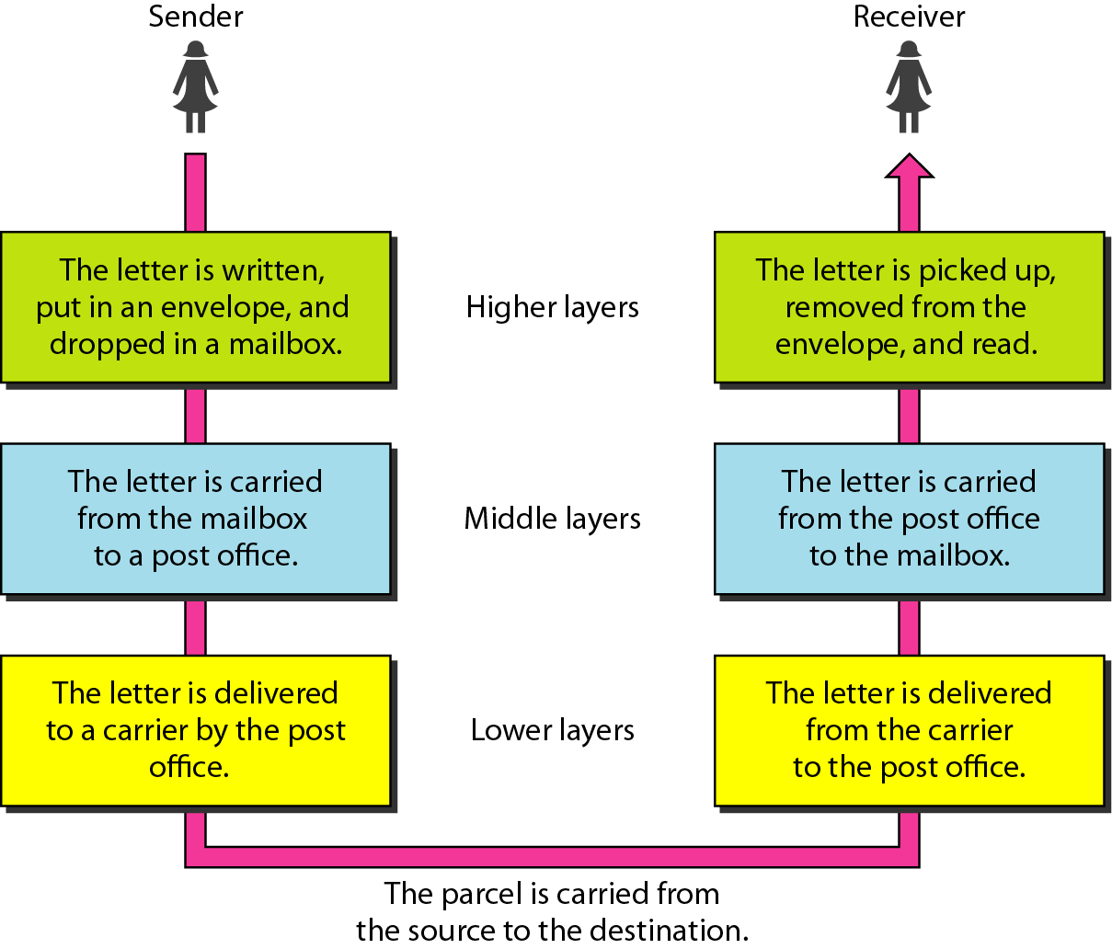
Tasks involved in sending a letter

Slide 9
Internet protocol stack
application: supporting network applications
FTP, SMTP, HTTP
transport: process-process data transfer
TCP, UDP
network: routing of datagrams from source to destination
IP, routing protocols
link: data transfer between neighboring network elements
Ethernet, 802.111 (WiFi), PPP
physical: bits “on the wire”
application
transport
network
link
physical

Slide 10

Note
the application layer provides services for an application program to ensure that effective communication with another application program in a network is possible

Slide 11


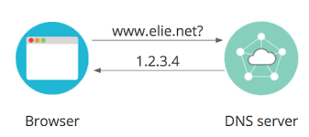
application: enable users/applications to access network resources
HTTP protocol (which provides for Web document request and transfer)
FTP protocol ( transfer of files between two end systems)
SMTP (transfer of e-mail messages)
DNS (Domain name system)
application
transport
network
link
physical

Slide 12
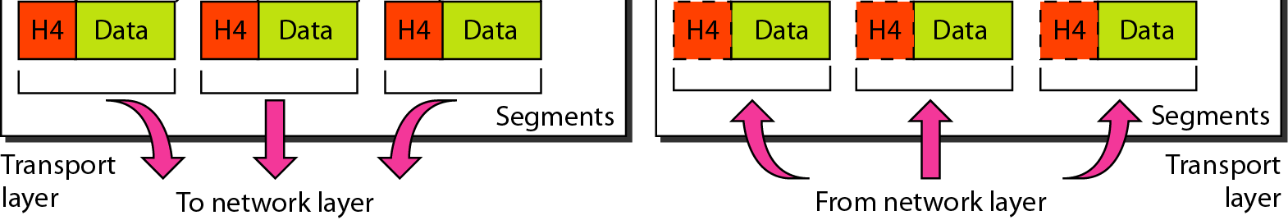
Transport layer
This layer divide the data into segments.
Transport Layer is where the decision to use TCP/UDP is made. Among commonly used protocols in this layer, TCP is reliable, UDP isn't.
Depending upon the choice made, the respective headers are attached to your packet.

Slide 13
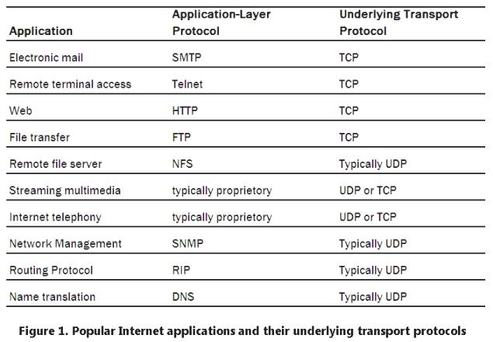
Transport layer (TCP/UDP)

Slide 14
Note
Now, after TCP/UDP header being appended, it moves on to the Network Layer. Till this step, the remote end-point's IP address wasn't a part of the packet at all.

Slide 15
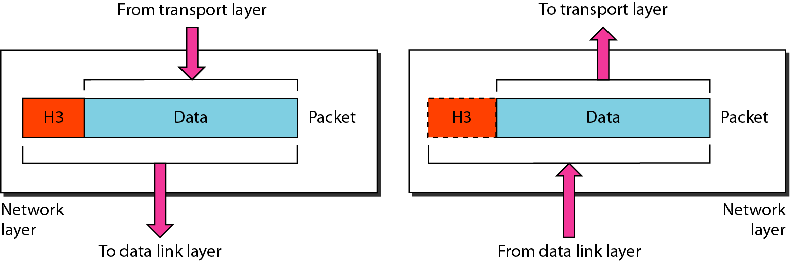
Network layer
The Internet transport-layer protocol (TCP or UDP) in a source host passes a transport-layer segment and a destination address to the network layer.

Slide 16
Network layer
The first physical equipment at the Network Layer would be Routers
It receives SEGMENTS from the upper layer and convert it into PACKETS.
Logical addressing: The network layer adds a header to the packet coming from the upper layer, includes the logical addresses (IP) of the sender and receiver.
Makes “Best Path Determination” decision based on logical addressing.

Slide 17
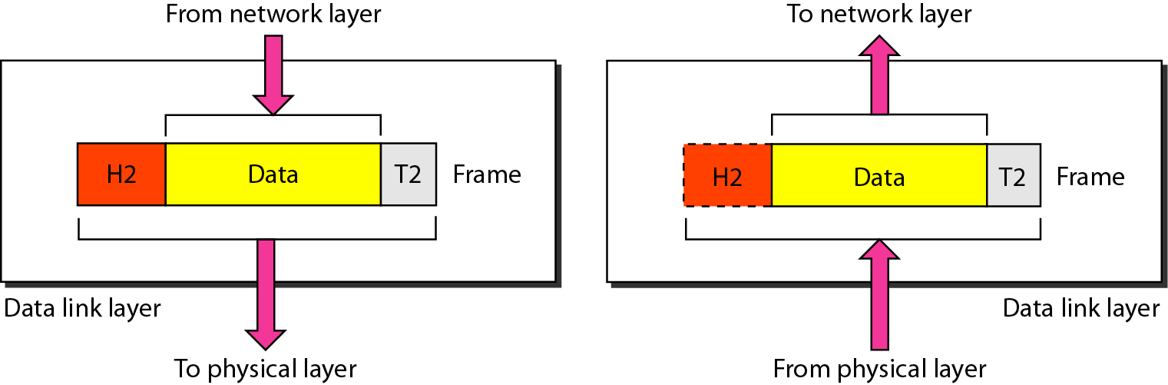
Link layer services
framing, link access:
specify the encapsulation of a packet into a frame and the techniques for getting the encapsulated packet on and off each medium.
channel access if shared medium
“MAC” addresses used in frame headers to identify source, dest (different from IP address!
Error checking

Slide 18
Physical layer
Defines the physical and electrical medium for data transfer.
Physical layer components: cables, jacks, punch blocks, hubs.

Slide 19
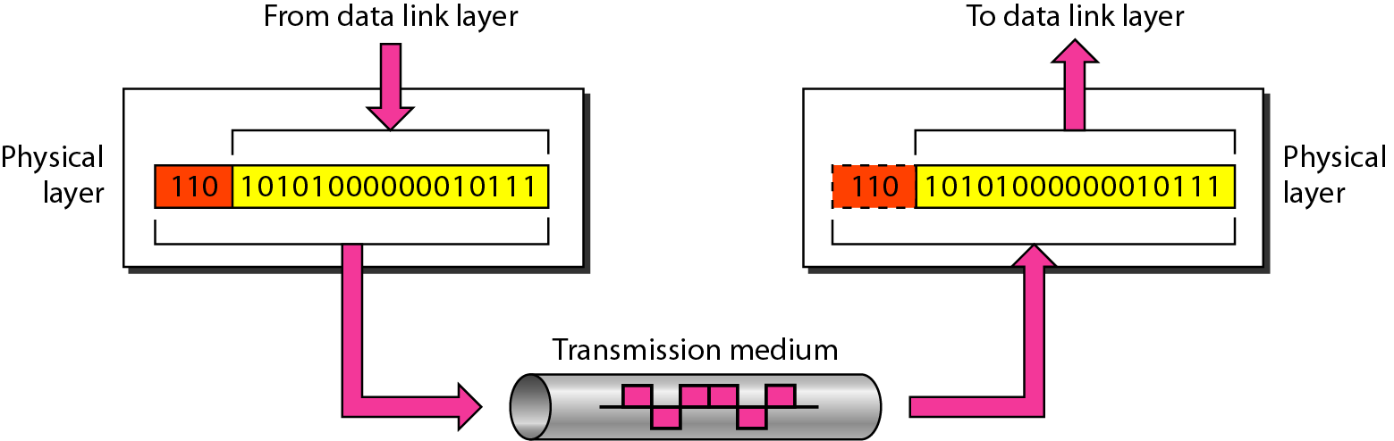
Physical layer

Slide 20
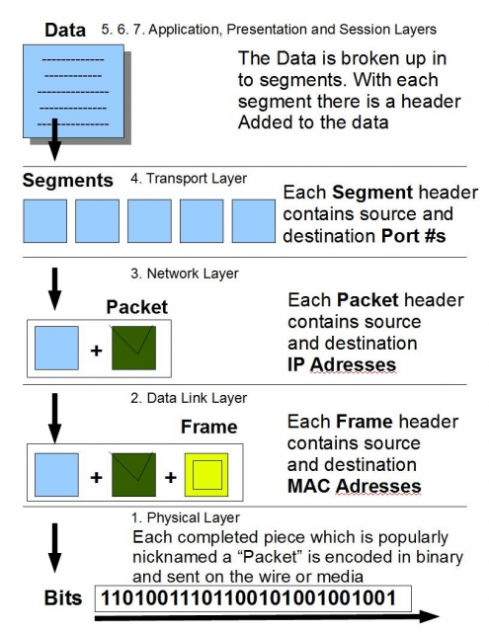

Slide 21
The OSI Model
Established in 1947, the International Standards Organization (ISO) is a multinational body dedicated to worldwide agreement on international standards. An ISO standard that covers all aspects of network communications is the Open Systems Interconnection (OSI) model. It was first introduced in the late 1970s.

Slide 22
Note
ISO is the organization. OSI is the model.

Slide 23
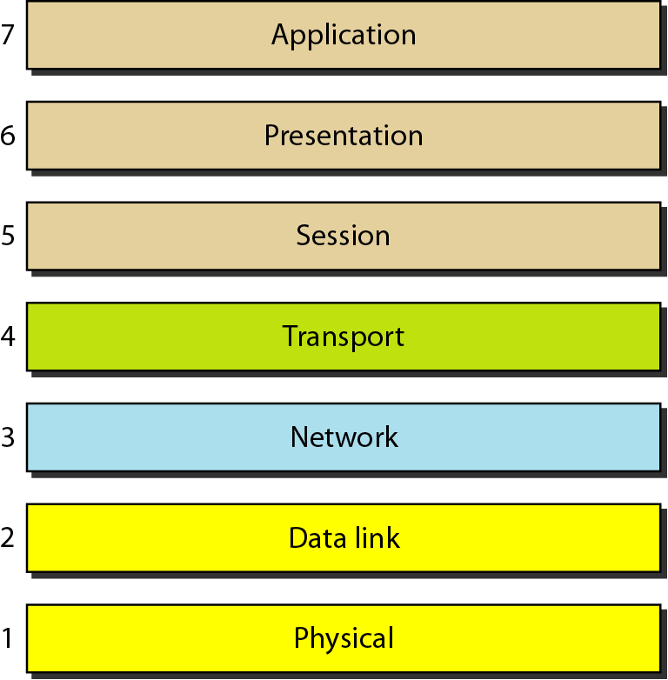
Seven layers of the OSI model
Data
Data
Data
Segment
Packet
Frame
Bits

Slide 24
Seven layers of the OSI model
Application

Slide 25


Seven layers of the OSI model
Data

Slide 26
Seven layers of the OSI model
TH | Seg1
TH | Seg2

Slide 27
Seven layers of the OSI model
TH | Seg2
NH|TH | Seg1

Slide 28
Seven layers of the OSI model
NH|TH | Seg2
DH|NH|TH | Seg1

Slide 29
Seven layers of the OSI model
DH|NH|TH | Seg2
01001010001010

Slide 30
Seven layers of the OSI model
DH|NH|TH | Seg1
01001010001010

Slide 31
Seven layers of the OSI model
NH|TH | Seg1
DH|NH|TH | Seg2

Slide 32
Seven layers of the OSI model
TH | Seg1
NH|TH | Seg2

Slide 33
Seven layers of the OSI model
TH | Seg2
TH | Seg1

Slide 34
Seven layers of the OSI model
Data

Slide 35

Computer Networking: A Top Down Approach 8th edition Jim Kurose, Keith Ross Addison-Wesley
A note on the origin of these ppt slides:
These slides are freely provided by the book authors and it represents a lot of work on their part. We would like to thank J.F Kurose and K.W. Ross.
Some slides adapted from the ones accompanying the book “The TCP/IP Protocol Suite”

